Slide 1

COFFEE SHOP SALES ANALYSIS
Bright light Coffee Shop

Slide 2
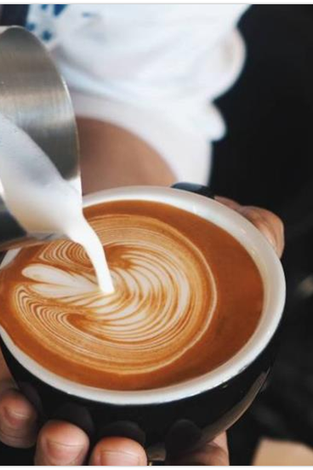
Introduction
Welcome to our coffee shop
analysis , where we explore the
science behind our thriving cafe.
From market trends and
Customer preference to branding
strategies. We delve into what makes
the coffee shop successful.

Slide 3
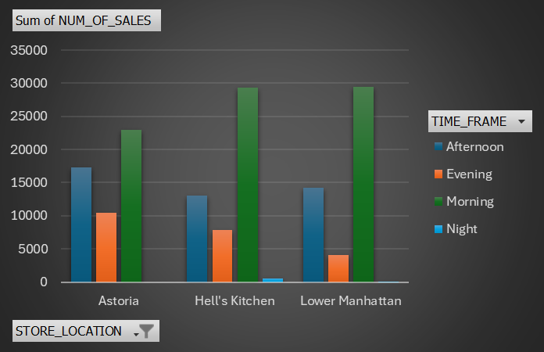
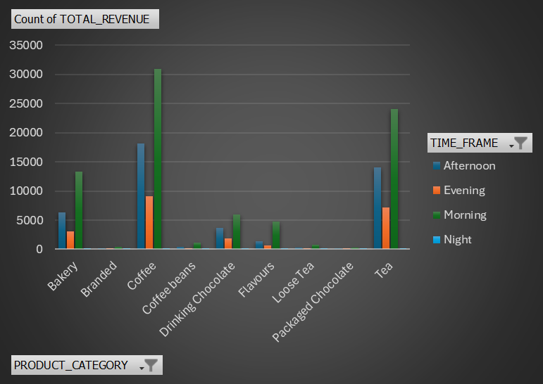
Number of sales by store location per timeframe
Number of sales by product category per timeframe
Insight:
Lower Manhattan and Hell’s Kitchen contributes the sale in the morning with 19,75% and 19,69%
While Astoria has highest sales at afternoon and evening with 11,56% and 6,99%
And at night the store locations seem to have low sales.
Insight:
Morning sales for coffee and tea contribute the highest sales at 20,75% and 16,12%
While branded, coffee beans, loose tea and packaged chocolate contribute the lowest sales.

Slide 4
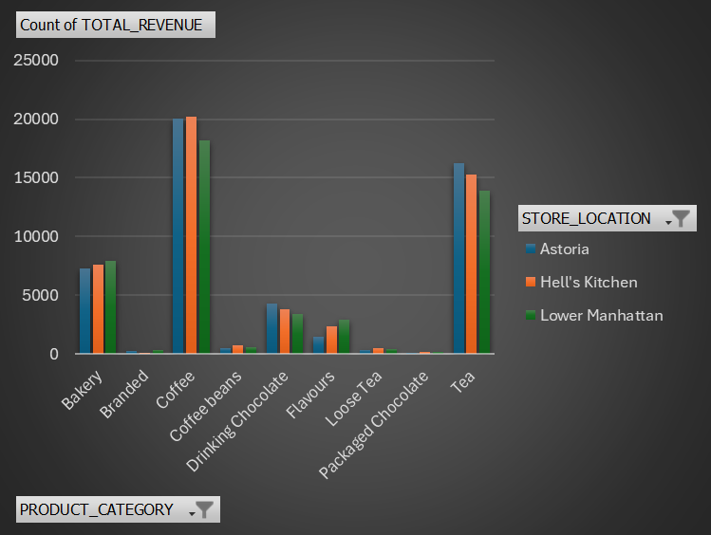
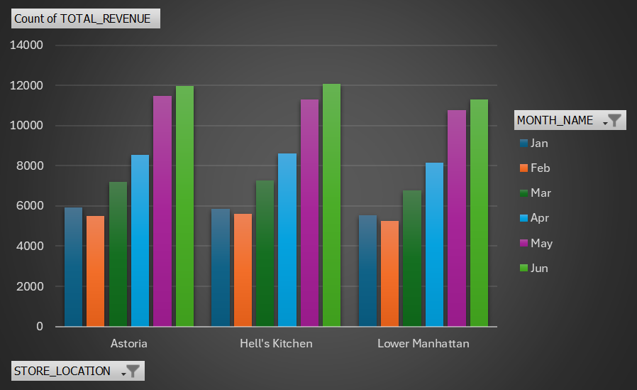
Product category sales per store location
Number of sales per month by store location
Insight:
Coffee sales at hell’s kitchen are at 39,79% while tea at astoria is at 32,14%
Lower Manhattan has the highest sales of bakery and flavours with 16,51% and 6,13%
Insight:
Hell’s kitchen has the highest total number sale with 34,02%
While Astoria has 33,93%
And Lower Manhattan with the lowest with 32,04%

Slide 5
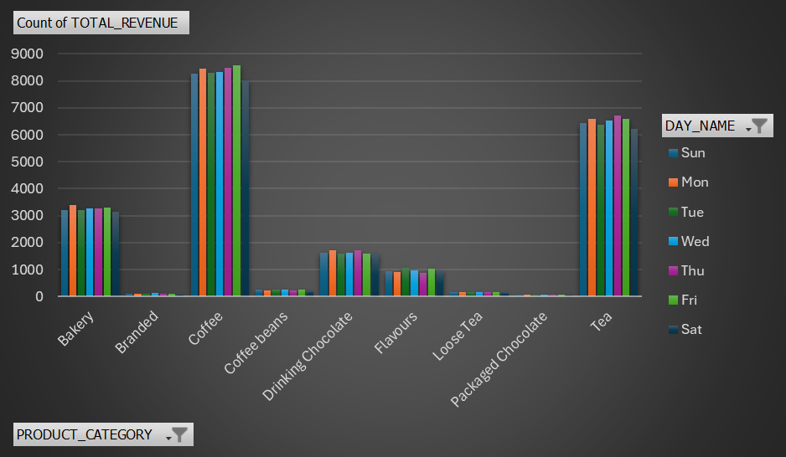
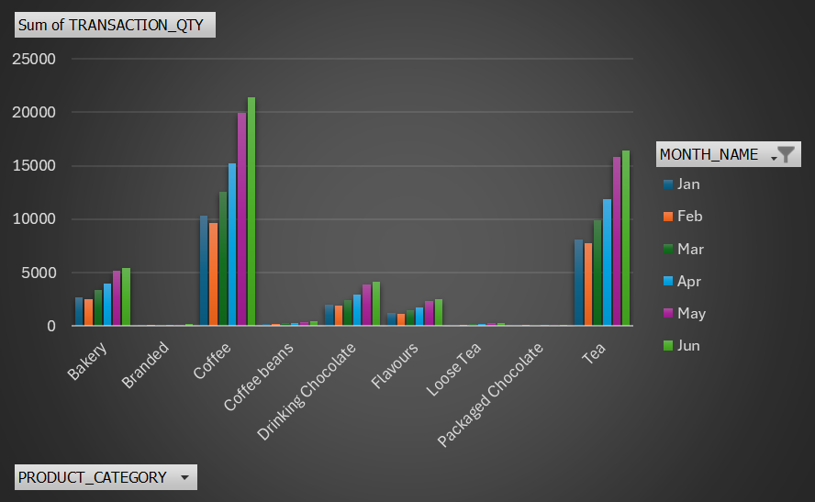
Product category sales per day
Product category sale per month
Insights:
Coffee contributes 39,17% of number sales
Tea with 30,48%
While branded, loose tea and packaged chocolate with the lowest number sale with 0,50%,0,81% and 0,33% each.

Slide 6
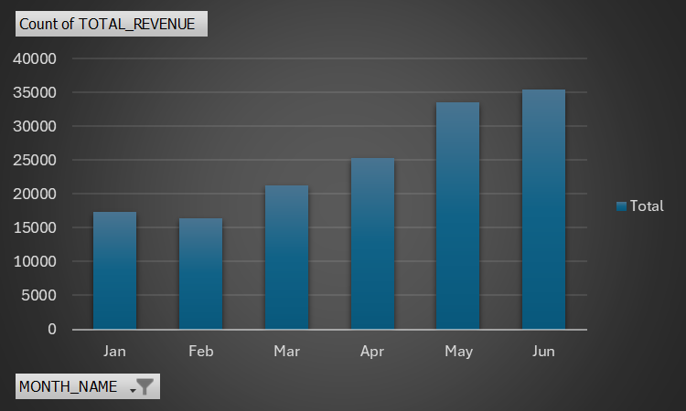
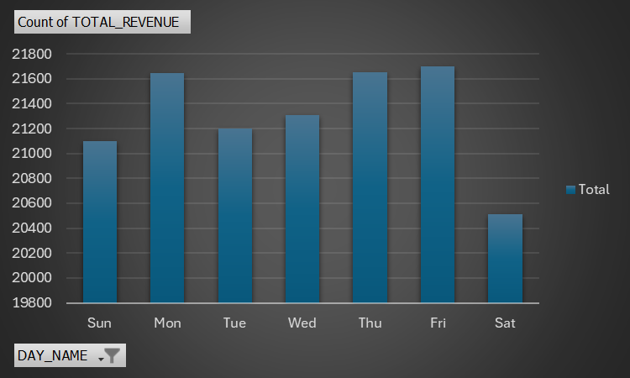
Total revenue per month
Total revenue per day
Insight:
June and May contributes the highest revenue
with 23,71% and 22,48%
While Jan and Feb have the lowest revenue with
11,61% and 10,97%
Insight:
Sat 13,75% with the lowest revenue
While the other days average 14% revenue

Slide 7
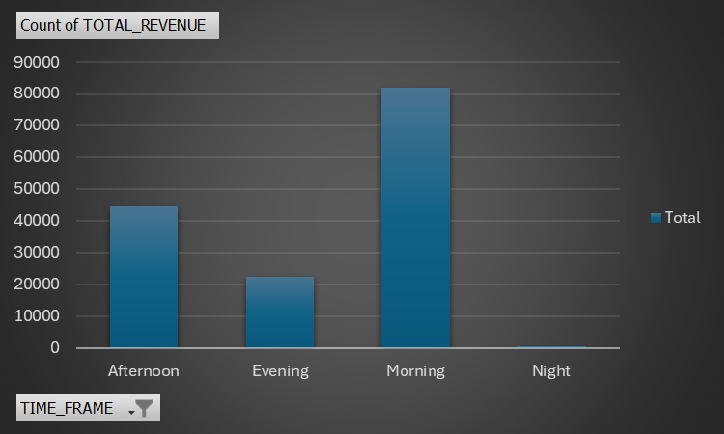
Sales per Timeframe
Insights:
Afternoon contributes 29,79% of the total revenue
While evening is 14,99%
The morning contribute the highest revenue with 54,82%
And night is lowest with 0,39%

Slide 8
Conclusion
Overall the coffee shop generates the good revenue from sales. In some days and timeframe like Saturday and the evening prices need be to cut in order to attract high number of customers. Some of the products need to be removed from the shops menu and push momentum on the products that are doing great.

